Slide 1




Environmental Variables &
Data Exploration
Sydney Barfus
University of Florida

Slide 2
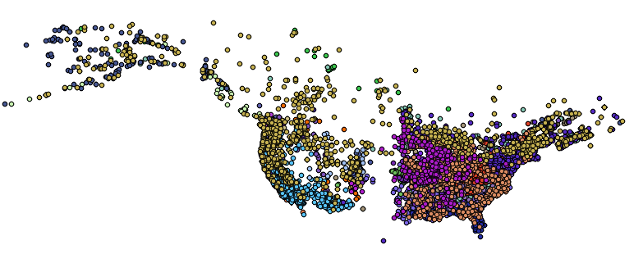
What data are we using?
1. Georeferenced occurrence records

Slide 3
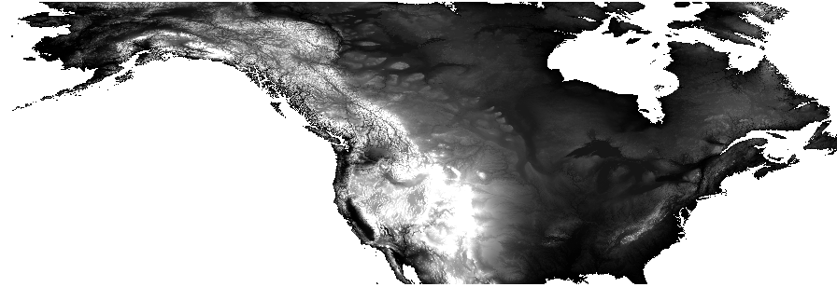
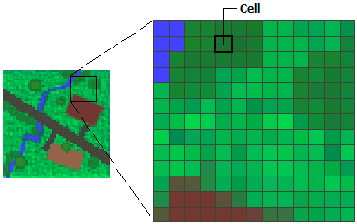
What data are we using?
2. Gridded abiotic data layers (or Raster)
Source: ArcMap

Slide 4
Abiotic data layers
What?
Temperature, precipitation, soil, vegetation, land use
Where?
Local, USA, North America, Global
When?
Past, current, future

Slide 5
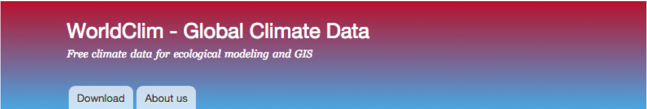


Data layer sources
WorldClim2
PRISM
SoilGrids
Unified North American Soil Map
USGS
EPA
NOAA
AquaMaps
PMIP
And more!
rWBclimate
prism
World
World
weathercan
getCRUCLdata
Canada
World
clifro
chirps
New Zealand
World

Slide 6
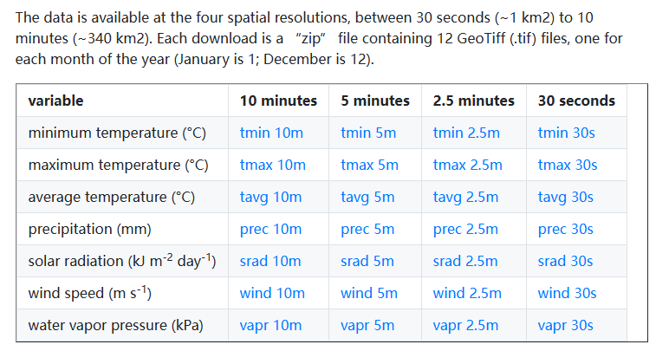
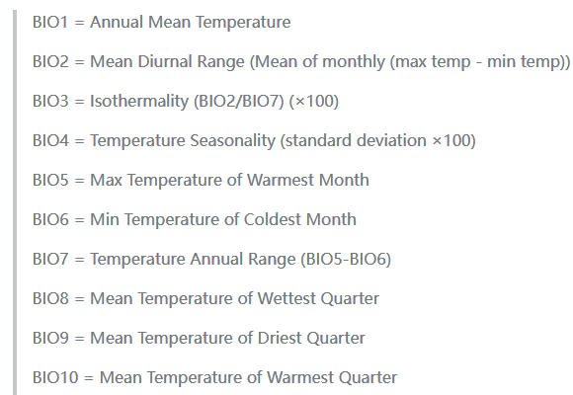
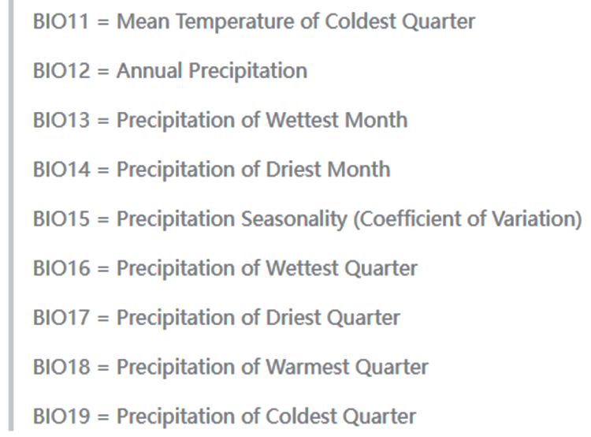
WorldClim
www.worldclim.org
Global
Past, Current and Future
WorldClim2 now available!
Multiple resolution options
19 Bioclimatic variables derived from monthly temperature and rainfall values

Slide 7
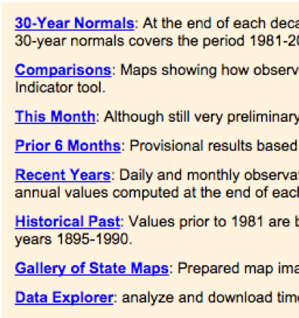
PRISM
www.prism.oregonstate.edu
US Only
Past and Current
More precise than WorldClim
Data available from 1895 to present
Lots of data and tools to explore

Slide 8
Soil Sources
SoilGrids2.0:
soilgrids.org
Global
Eight characteristics of topsoil and subsoil
2.5 arc second resolution
mgaynor1/long-winded-scripts/SoilGridDownload/

Slide 9
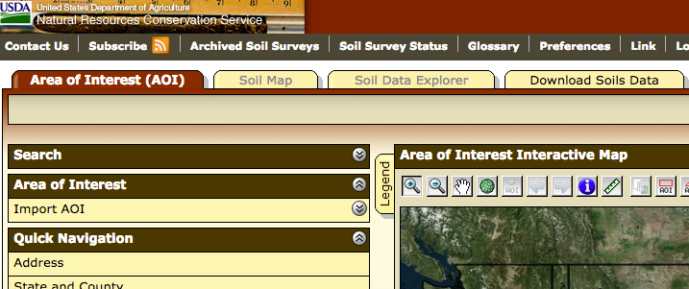
Soil Sources
SoilGrids2.0:
soilgrids.org
Global
Eight characteristics of topsoil and subsoil
2.5 arc second resolution
USGS
websoilsurvey.sc.egov.usda.gov
US Only
Need to define Area of Interest
Big files, Tough to get large areas

Slide 10
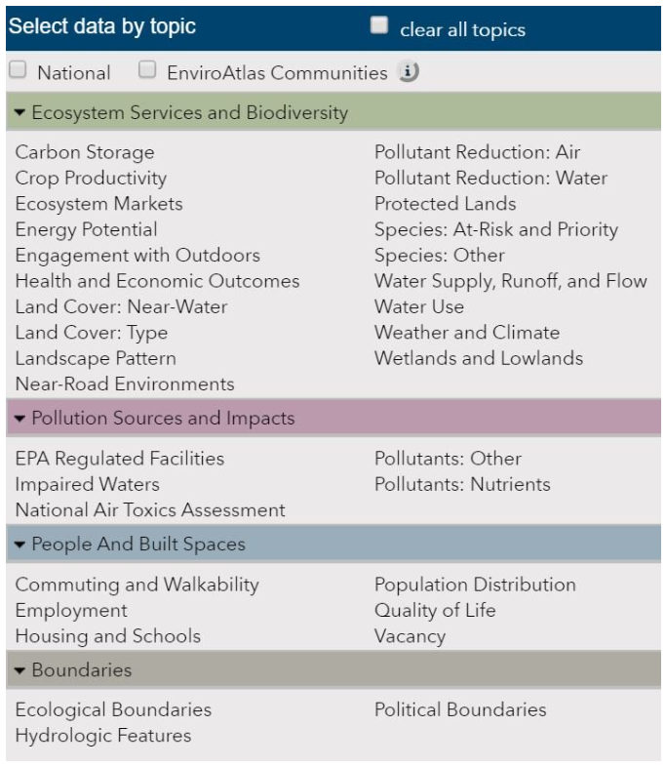
EPA
https://www.epa.gov/enviroatlas
US Only
Selected high-population regions at higher resolution
Interactive tool and downloadable data
Air quality, bodies of water, land use, boundaries, housing, and much more
Notes:
amount of pavement

Slide 11
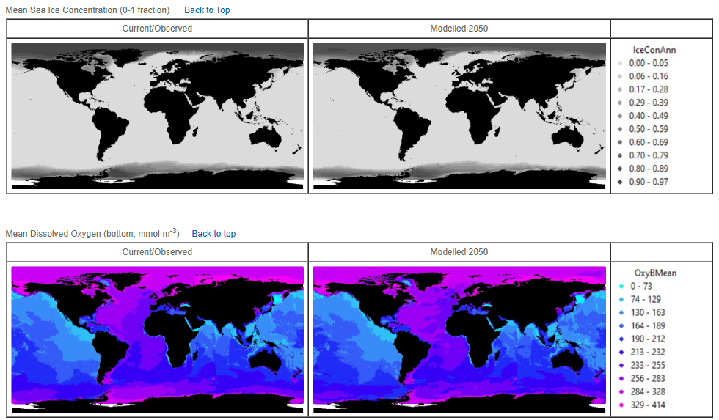
Other Sources
Paleoclimate data
NOAA/NCEI: ncei.noaa.gov/products/paleoclimatology
PMIP: pmip.lsce.ipsl.fr
PaleoClim: paleoclim.org
Aquatic Environments
AquaMaps: aquamaps.org/main/envt_data.php
Hourly or Daily data:
OGIMET: ogimet.com
Daymet: daymet.ornl.gov
Source: AquaMaps

Slide 12
Data Exploration
Now What?
We have:
Cleaned, georeferenced occurrences
Environmental variables of interest
Now: examine the data to determine variables of interest, possible issues, and developing trends

Slide 13
PCA
Principal Component Analysis
Transforms data into new set of variables, called Principal Components (PC1, PC2, …)
Loading: how much each original variable contributes to a PC
Can calculate and examine the relative contributions of each climatic variable to each PC
Reveals top loading variables

Slide 14
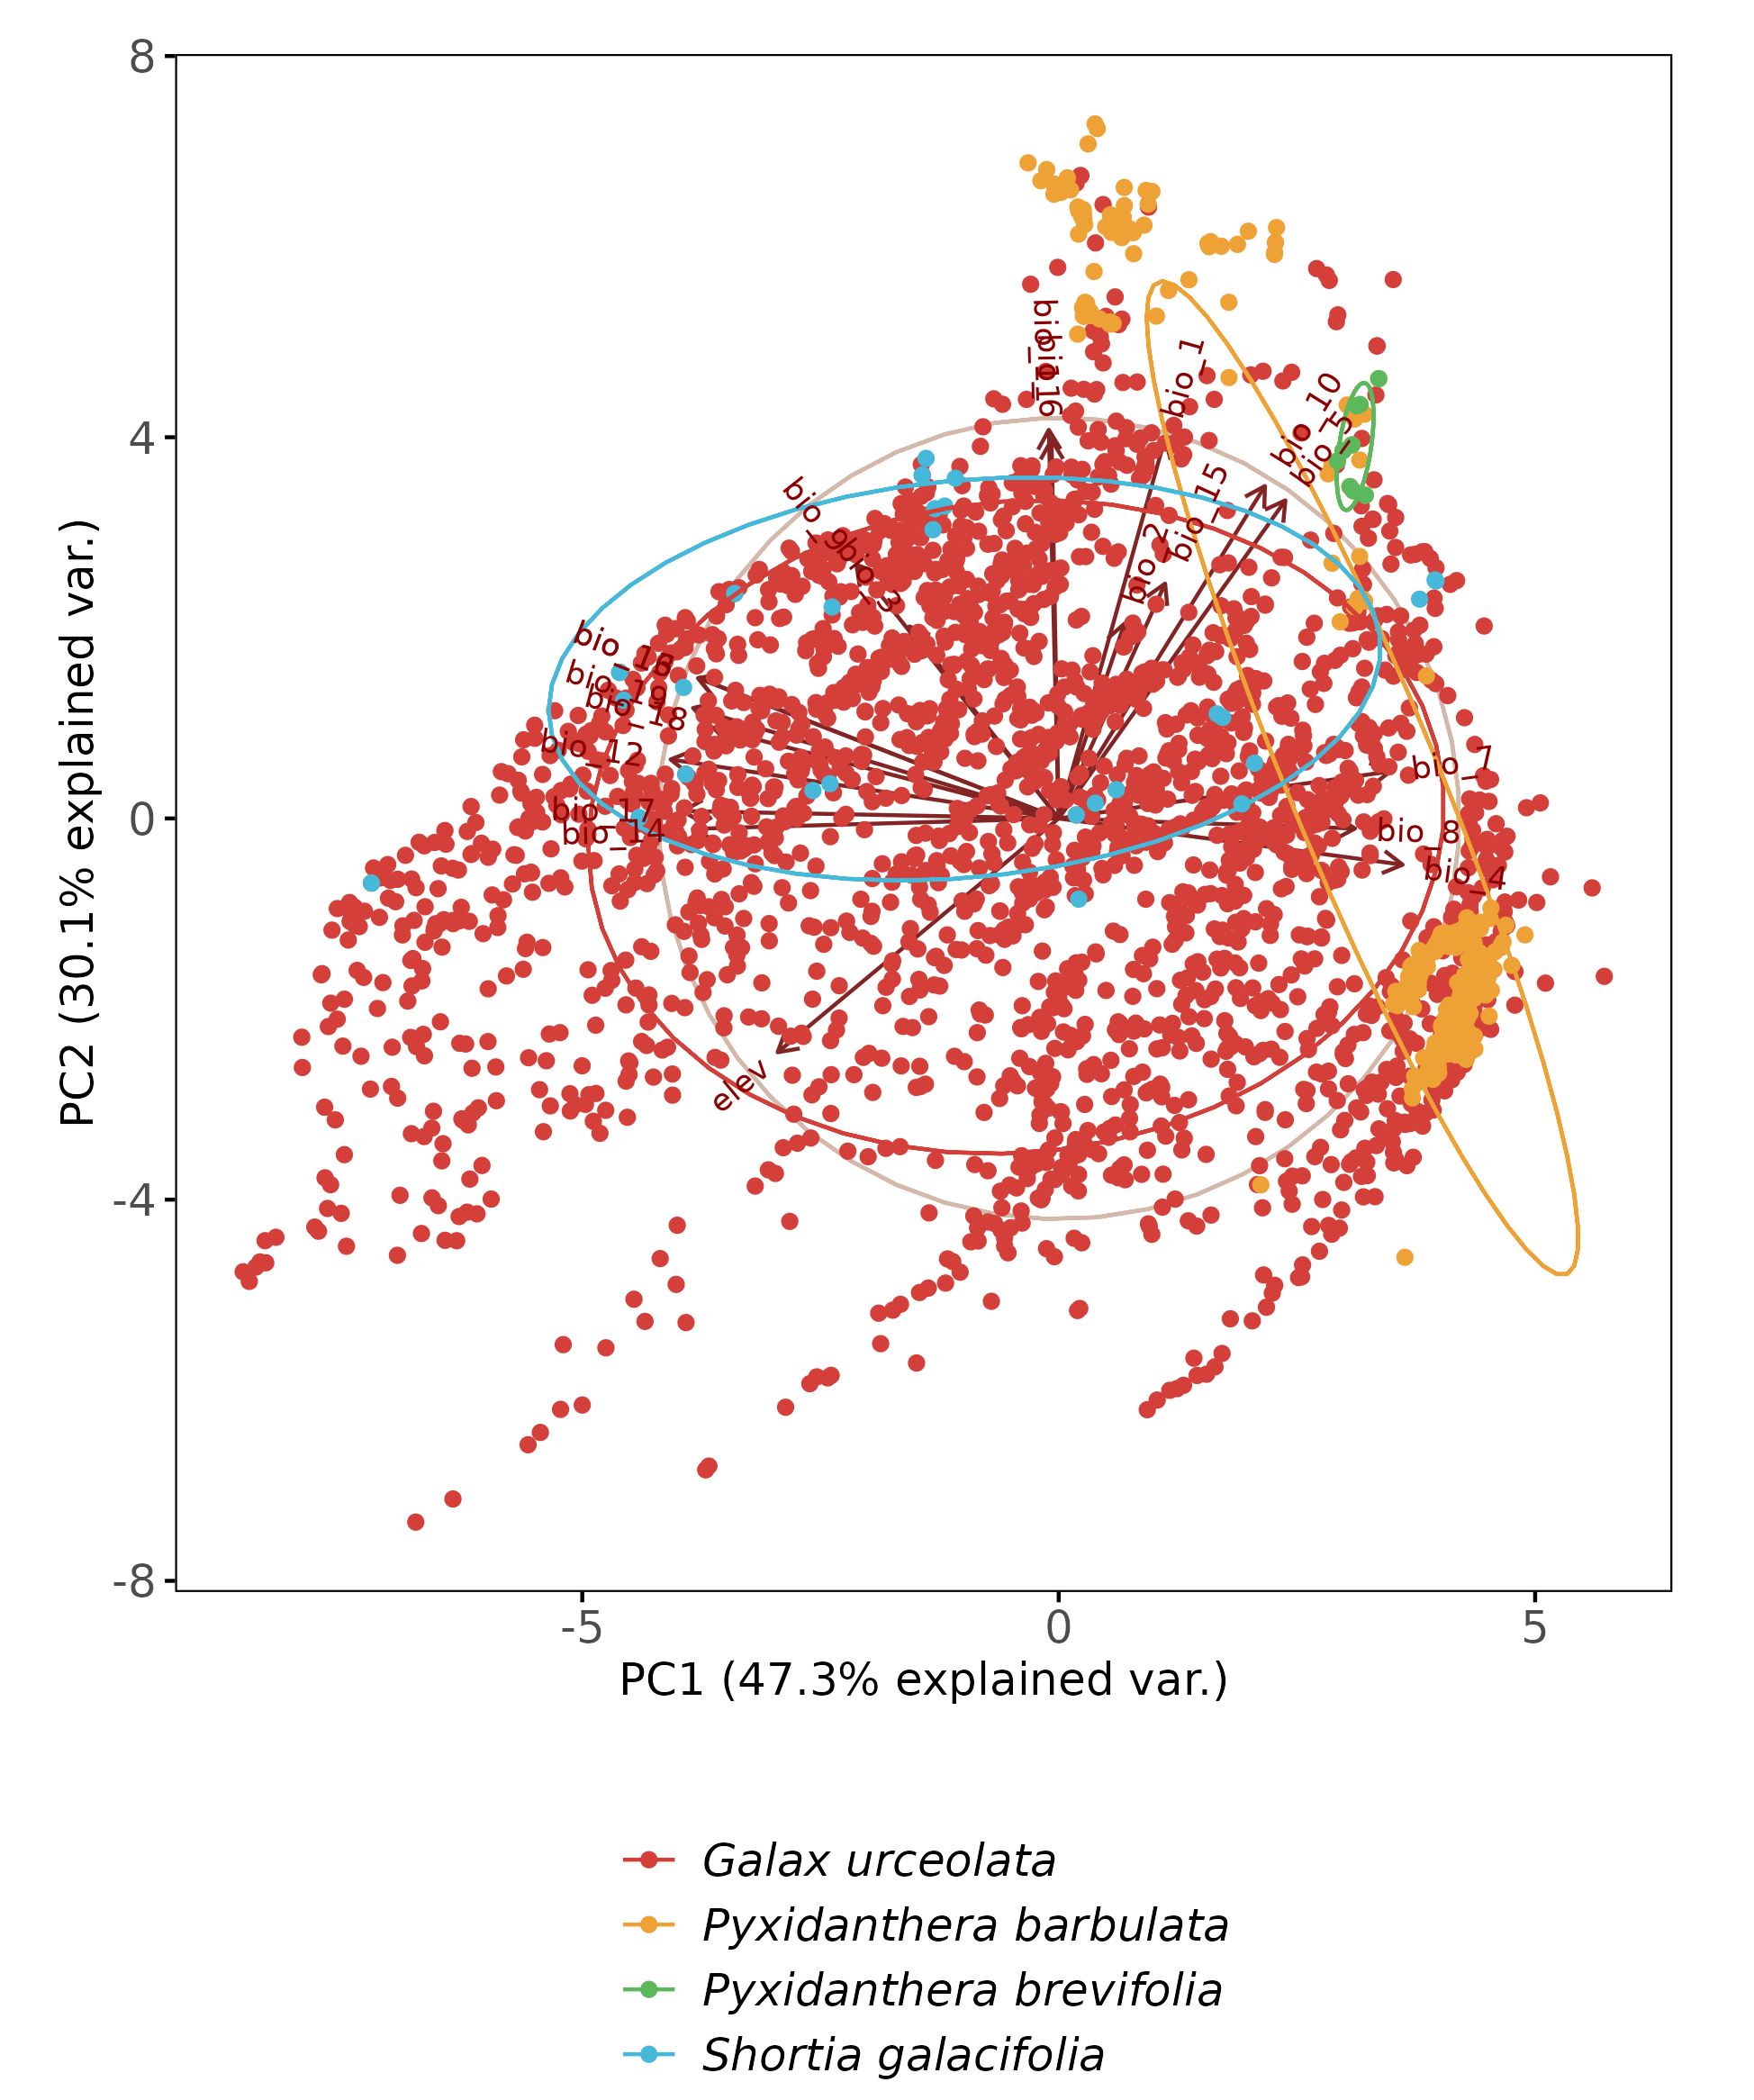
PCA
Summarize many environmental variables into PCs
Reveal groupings that are not obvious in raw data
Plotting the PCA:
Points: observations
Arrows: environmental variables
Ellipse Groupings: Species

Slide 15
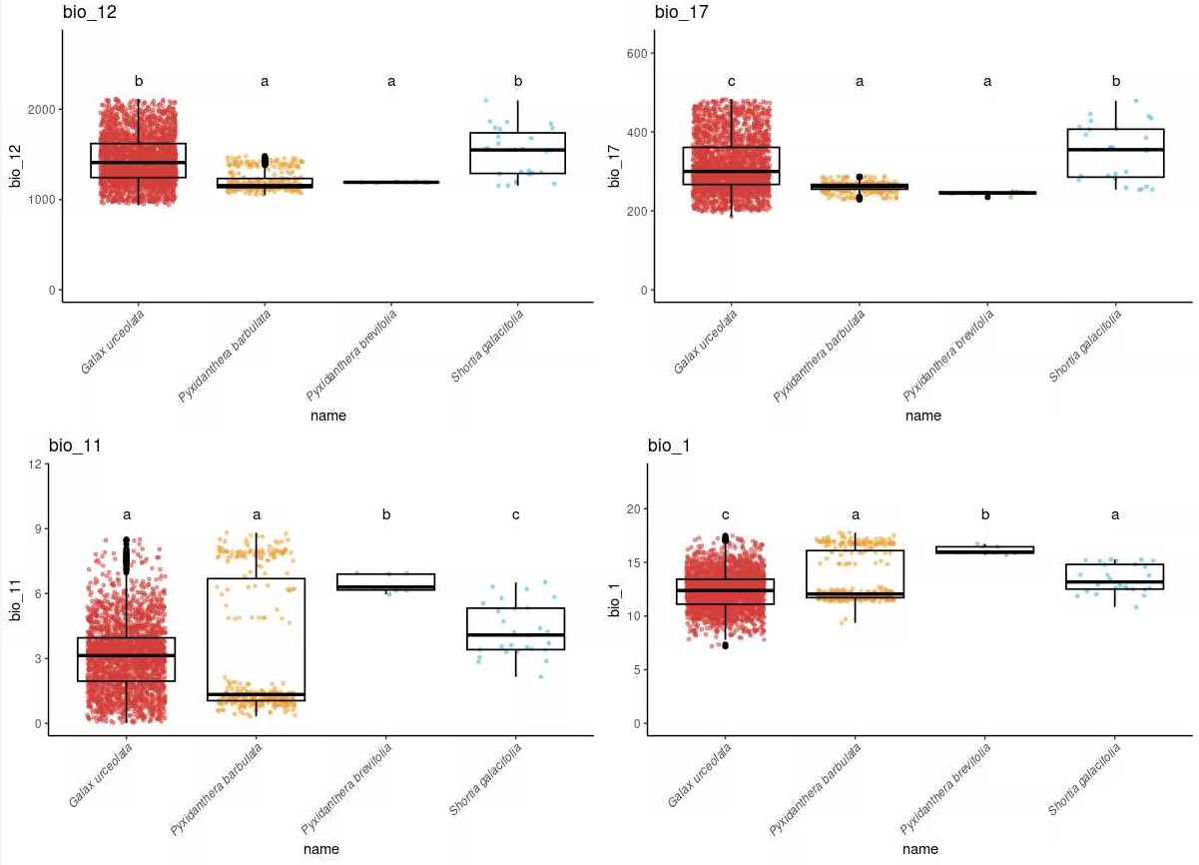
ANOVA
Select the top two loading variables for the top two PCs
Shows if each species is significantly different
Add Tukey HSD test to determine which species are significantly similar/different

Slide 16
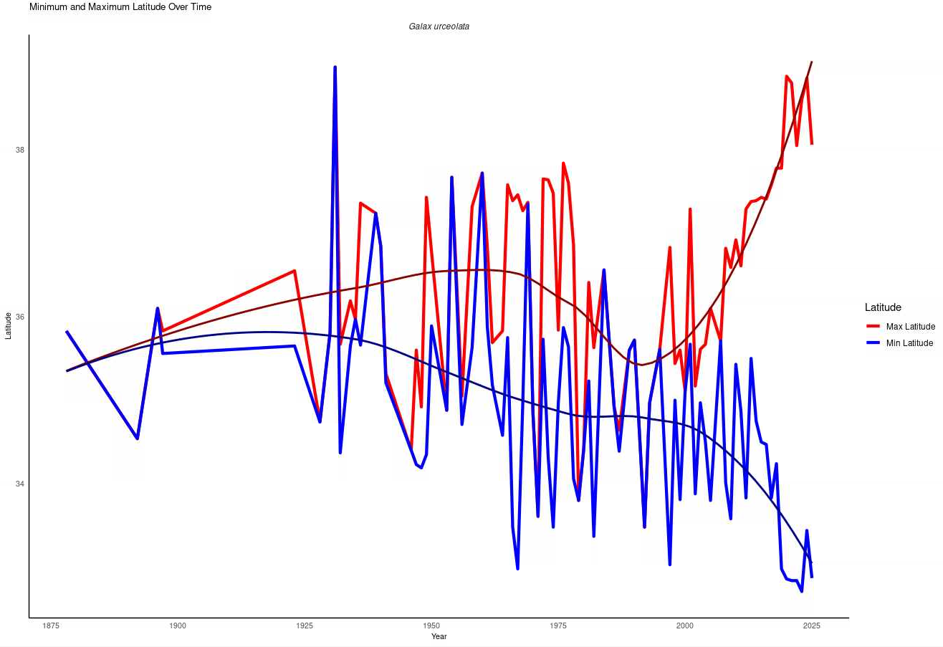
Range Shifts Over Time
Does not rely on environmental variables
Uses dates of occurrence records to identify historical trends in distribution over time
Latitude vs Time
Must consider potential impacts of increases in volume of occurrence records over time

Slide 17
Importance
Data Exploration can reveal:
Potential issues, biases, and discrepancies in raw data
Trends that are worth exploring further
Population/species differences
Data exploration allows us to examine the reliability of data before putting it into the ENM models

